Slide 1

Cybersecurity internship
Week 7/8– presentation 6
Intern: Assil Bzal

Slide 2
Outline
Threat modeling examples
Smart home assistants (Alexa)
Airplane in-flight entertainment system
PYTM : Python Threat Modeling
Features
Usage
Creating a threat model
Generating diagrams
Creating a report
Overrides
Threats Databases

Slide 3
1. Smart home assistant
Assets:
Voice commands and transcripts
User profiles, schedules, routines
Connected device control (locks, lights)
Network access token
- Entry points:
Microphone (voice input)
Cloud API / voice service
Local network (Wi-Fi)
Companion mobile app / skill integrations
Bluetooth / smart home bridges
- Likely attackers:
Neighbor, casual thief, nation state (less likely), malicious skill developer, local network attacker

Slide 4
1. Smart home assistant
Top threats:
Unauthorized device control (compromise voice or cloud token) : High
Eavesdropping / voice data leakage (sensitive conversations) :High
Malicious third-party skill abusing permissions : Medium
Replay or injection of voice commands (playback attacks) : Medium
Lateral movement from companion app to other home devices : High
- Quick mitigations:
Strong authentication for companion app.
Encrypt data in transit and at rest..
Require voice confirmation for critical actions (unlock, disarm).
Rate-limit and anomaly detection for unusual commands.
Network segmentation (IoT VLAN) and disable unused interfaces.

Slide 5
Design phase
How it works
Local device with mic + speaker; does keyword detection locally, sends audio snippets to cloud for NLU; cloud services return intents; companion mobile app for user config; connects to smart-home devices via local hub or cloud integrations.
Every service consumed
STT/NLU cloud service, account/auth service (OAuth), device provisioning service, skill/third-party integration platform, cloud storage (logs/transcripts), analytics/telemetry, push notifications, OTA firmware update service.
Assumptions about environment & defaults
Home network reasonably secured (WPA2/3), companion app access controlled by user, device has secure boot/firmware signing, default wake-word limits accidental activation, skills vetted by platform.

Slide 6
Break phase
Approach: attacker-focused : think how an adversary would get persistent unauthorized control or eavesdrop. Also note protect-focused controls you’d implement.
STRIDE threats (top examples)
Spoofing: fake cloud endpoints, stolen tokens.
Tampering: malicious skill modifies routines.
Repudiation: lack of logs for who issued critical commands.
Information Disclosure: audio transcripts leaked, cloud backups exposed.
Denial of Service: overload voice service/kill skill.
Elevation of Privilege: skill gains more permissions than intended.

Slide 7
Fix phase
Map threats → components/interactions
Token theft → companion app.
Malicious skill → skill platform + device intent parser.
Eavesdropping → mic → audio preprocessing → cloud storage.
Prioritize (risk)
Unauthorized device control: High impact × Medium likelihood → High.
Eavesdropping of private audio: High × Medium → High.
Malicious skill abuse: Medium × High → High.
DoS of voice service: Medium × Medium → Medium.
Threat library entries (example)
ID: SHA-001 : Unauthorized unlock via voice replay. Assets: door lock. Controls: voice-auth confirmation + challenge-response + rate limiting. Residual: require manual unlock after N attempts.
ID: SH-002 : Token theft of mobile app. Controls: mutual TLS, short-lived tokens, device bind, MFA for sensitive ops.

Slide 8
Verify phase
Validate/accept threats with rationale
Confirm high-risk controls (voice confirmation, token expiry) are in place; accept residual risk for rare physical replay if user chooses convenience.
Confirm mitigations practical
Test via red-team simulation (non-invasive), token replay tests, skill permission audits.
Update model as system evolves
Re-run after new integrations, firmware changes, or addition of third-party skills.

Slide 9
2.Airplane in flight entertainment system
Assets:
Passenger PII/payment data (if purchasing)
IFE software / media content
Aircraft avionics interface (if incorrectly connected)
Inflight network infrastructure
Entry points:
Passenger device USB / HDMI / Bluetooth
Cabin Wi-Fi and passenger interfaces
Maintenance port / onboard service access
Content delivery system / ground sync
Likely attackers:
Malicious passenger, insider (maintenance crew), organized criminals, nation state (targeting avionics via bridging)

Slide 10
2.Airplane in flight entertainment system
Top threats:
Lateral movement to critical avionics via misconfigured bridges : High (severe)
Theft of payment/PII via compromised purchase system : High
Malware via USB/OTG or infected content : Medium
Denial of service disrupting entertainment or passenger comms : Medium
Unauthorized content injection (piracy, propaganda) : Low
Quick mitigations:
Strict network segmentation: IFE isolated from avionics with hardware enforced separation.
Harden USB/media interfaces; disable write access; scan media.
Encrypted payment flows; PCI compliance.
Harden maintenance access with MDM, logging, multi-party authentication.
Regular patching and supply chain validation for content servers.

Slide 11
Design phase
How it works
IFE hardware in cabin; media server(s) on aircraft; passenger devices connect via cabin Wi-Fi; payments handled via PCI-capable gateway; maintenance access for content sync/updates via secure ground link or maintenance port.
Services consumed
Content distribution/DRM service, passenger wi-fi ISP gateway, payment processor, maintenance provisioning service, logging/telemetry to airline backend.
Assumptions & defaults
Physical and logical segregation between IFE and avionics; maintenance ports disabled or authenticated; IFE runs hardened OS; avionics network is air-gapped.

Slide 12
Break phase
Approach: protect-first for safety (isolate avionics) + attacker-focused to find bridging vectors.
STRIDE threats
Spoofing: fake maintenance console or update server.
Tampering: malware in content update; USB-borne malware.
Repudiation: insufficient logging of maintenance actions.
Info Disclosure: passenger payment data leakage.
DoS: overload IFE or cabin Wi-Fi affecting passenger comms.
Elevation: IFE gaining access to aircraft network via misconfiguration.

Slide 13
Fix phase
Map threats → components
Malicious update → content update service & maintenance link.
Payment data theft → IFE payment module → airline backend.
Prioritize threats
Avionics bridging (tampering/elevation): Critical.
Payment/PII theft: High.
USB/guest-supplied malware: Medium.
Threat library snippets
ID: IFE-AV-001 : Cross-network escalation to avionics. Controls: hardware firewall, one-way data diodes, separate physical NICs, enforce no shared storage.
ID: IFE-PAY-002 : Payment data exposure. Controls: PCI DSS, tokenization, encrypted in-transit & at-rest.

Slide 14
Verify phase
Validate
Penetration test focusing on IFE ↔ avionics separation (but coordinated, non-destructive). Confirm signed updates and content validation.
Confirm practicality
Verify that hardware separation and data diode are implementable within aircraft weight/space constraints.
Update model
After any maintenance-access change, third-party vendor update, or cabin Wi-Fi ISP change.

Slide 15

But is the traditional way of threat modeling the best way to do what’s needed?

Slide 16
PYTM : python threat modeling
This is why PYTM was created
Traditional threat modeling too often comes late to the party, or sometimes not at all. In addition, creating manual data flows and reports can be extremely time-consuming. The goal of pytm is to shift threat modeling to the left, making threat modeling more automated and developer-centric.

Slide 17
Features of PYTM
Based on your input and definition of the architectural design, pytm can automatically generate the following items:
Data Flow Diagram (DFD)
Sequence Diagram
Relevant threats to your system
Requirements
Linux/MacOS
Python 3.x
Graphviz package
Java (OpenJDK 10 or 11)
plantuml.jar

Slide 18
What is plantuml.jar ?
The file plantuml.jar is the executable Java archive for PlantUML, a tool that generates UML (Unified Modeling Language) and other diagrams from plain text descriptions.
Here’s what it’s used for:
Diagram Generation It takes a simple text-based syntax (written in .puml or .plantuml files) and converts it into diagrams such as:
Class diagrams
Sequence diagrams
Activity diagrams
Use case diagrams
State diagrams
Component & deployment diagrams
Gantt charts, mind maps, wireframes, etc.
Automation & Integration Since it’s a .jar file, you run it with Java (java -jar plantuml.jar) and feed it text files. It then produces output images (e.g., PNG, SVG, EPS, PDF).

Slide 19
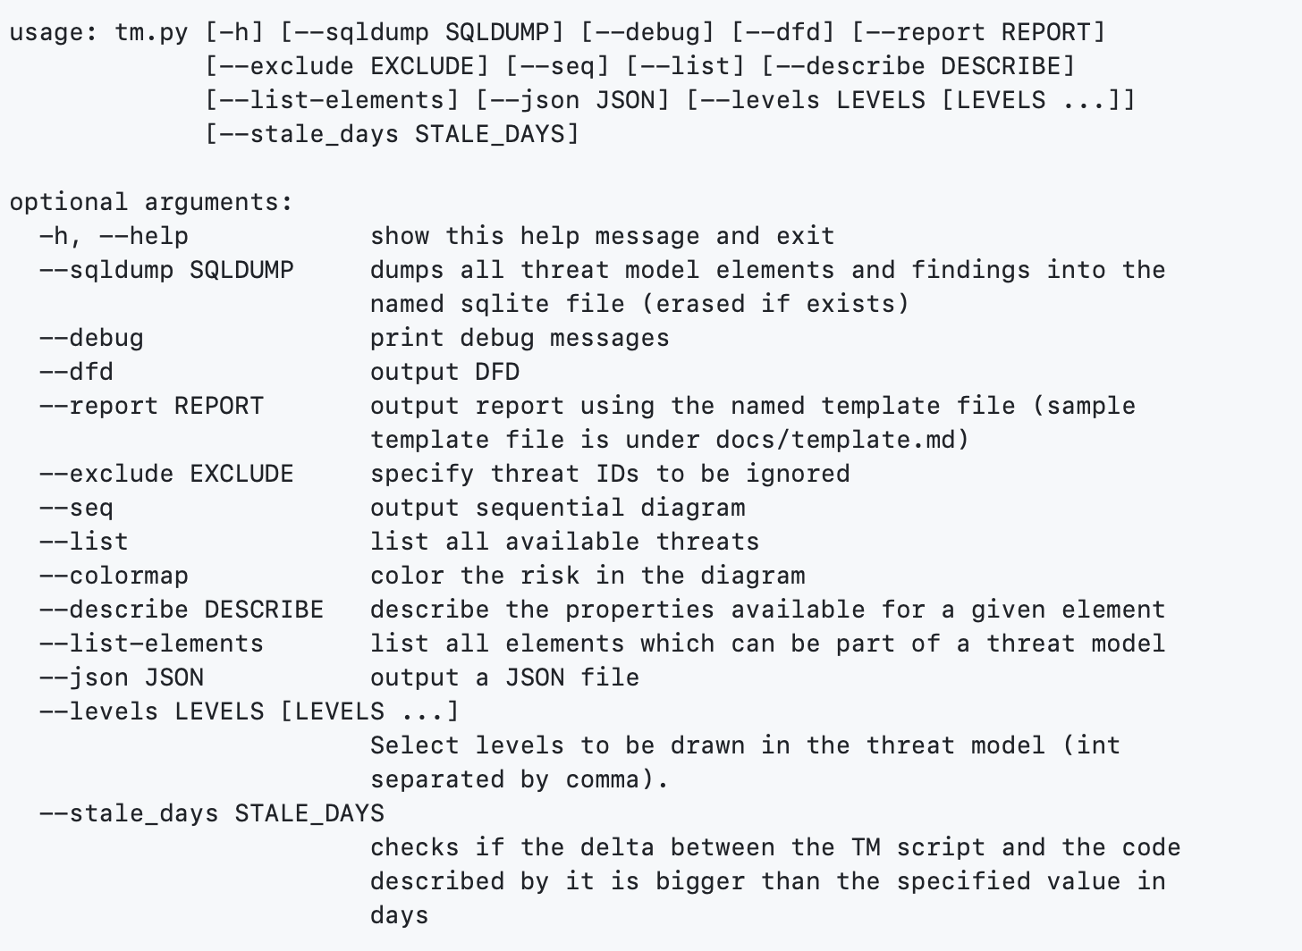
Usage
All available arguments:

Slide 20
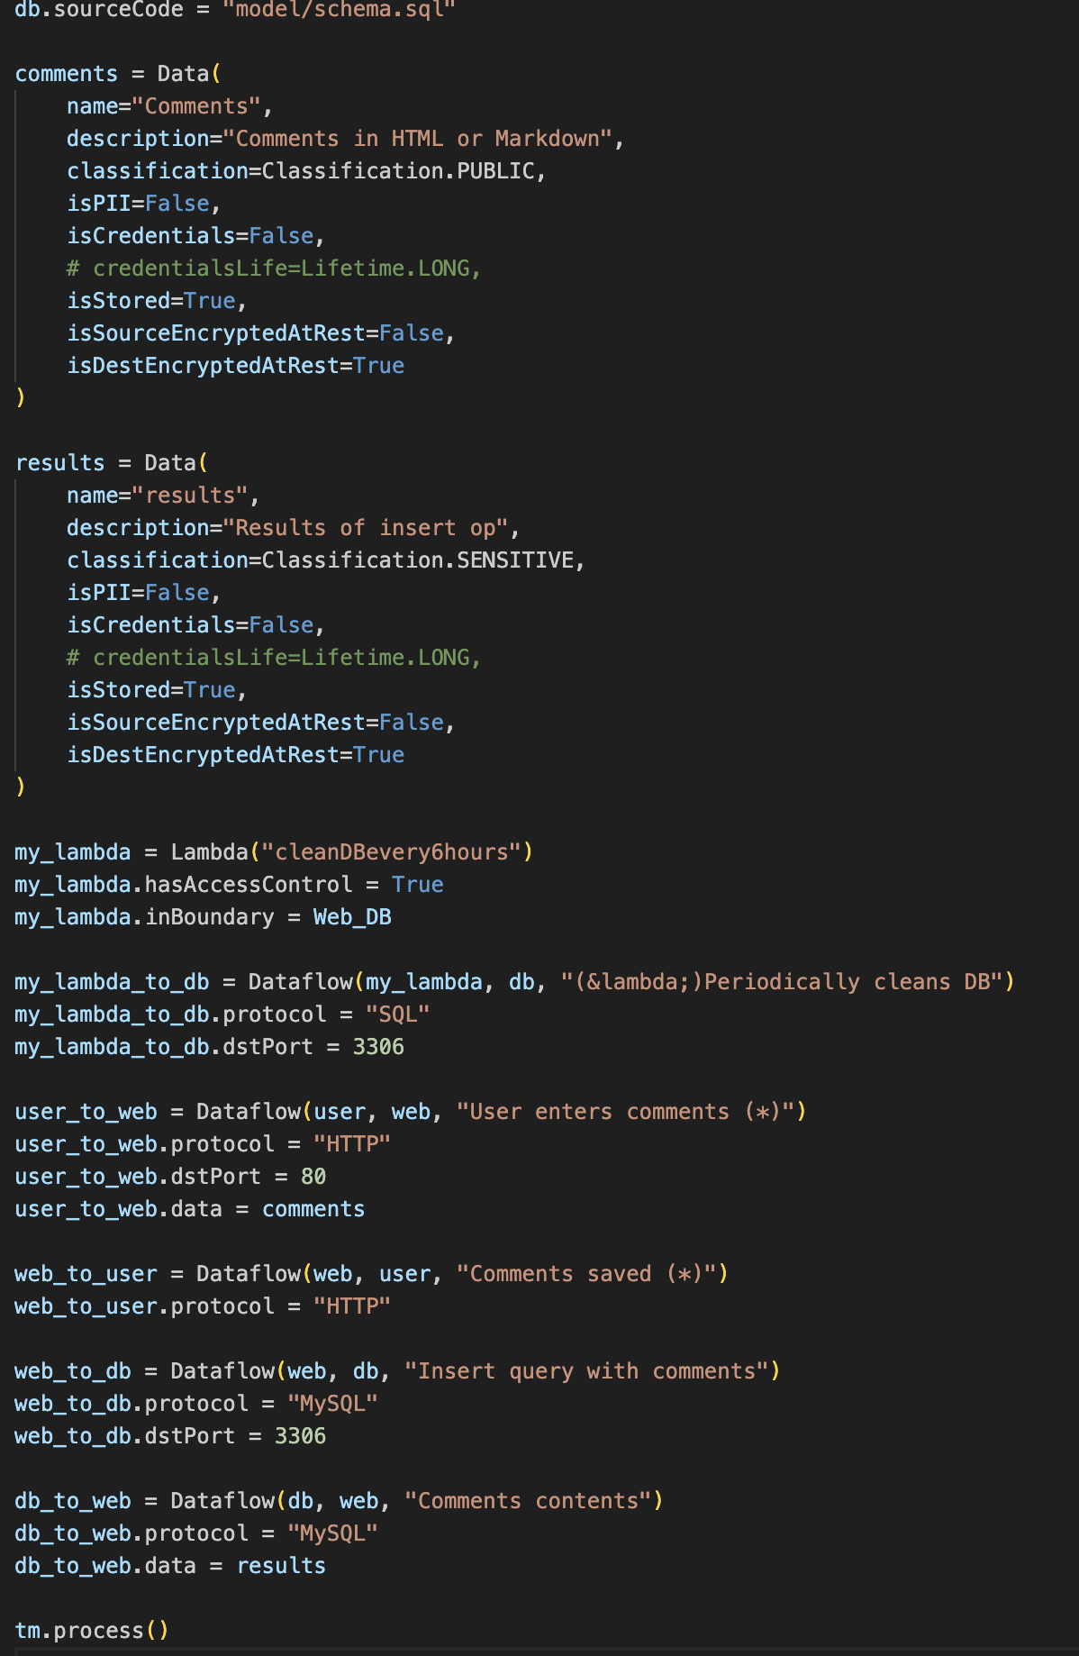
Creating a Threat Model
The following is a sample tm.py file that describes a simple application where a User logs into the application and posts comments on the app. The app server stores those comments into the database. There is an AWS Lambda that periodically cleans the Database.

Slide 21
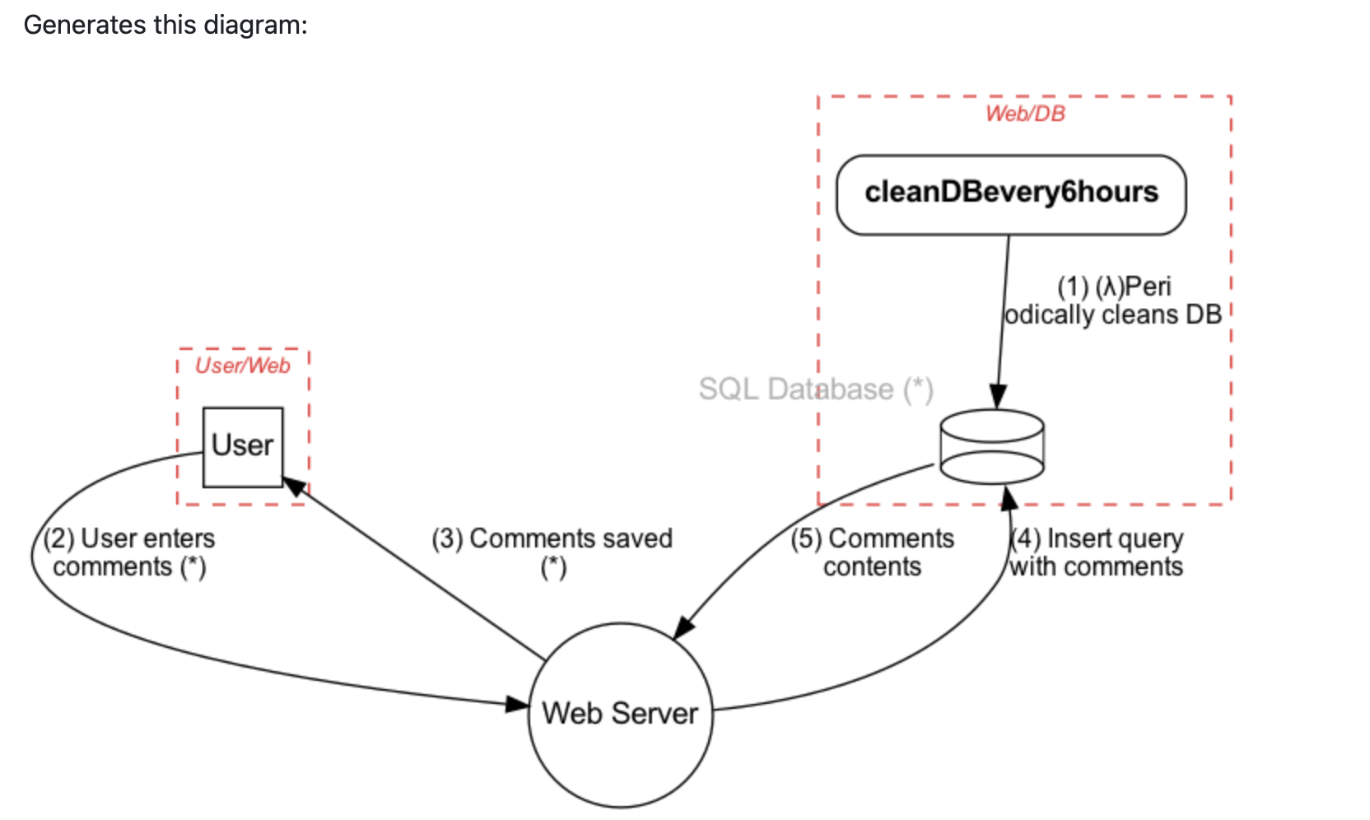
Generating Diagrams
When --dfd argument is passed to the above tm.py file it generates output to stdout, which is fed to Graphviz's dot to generate the Data Flow Diagram: tm.py --dfd | dot -Tpng -o sample.png

Slide 22
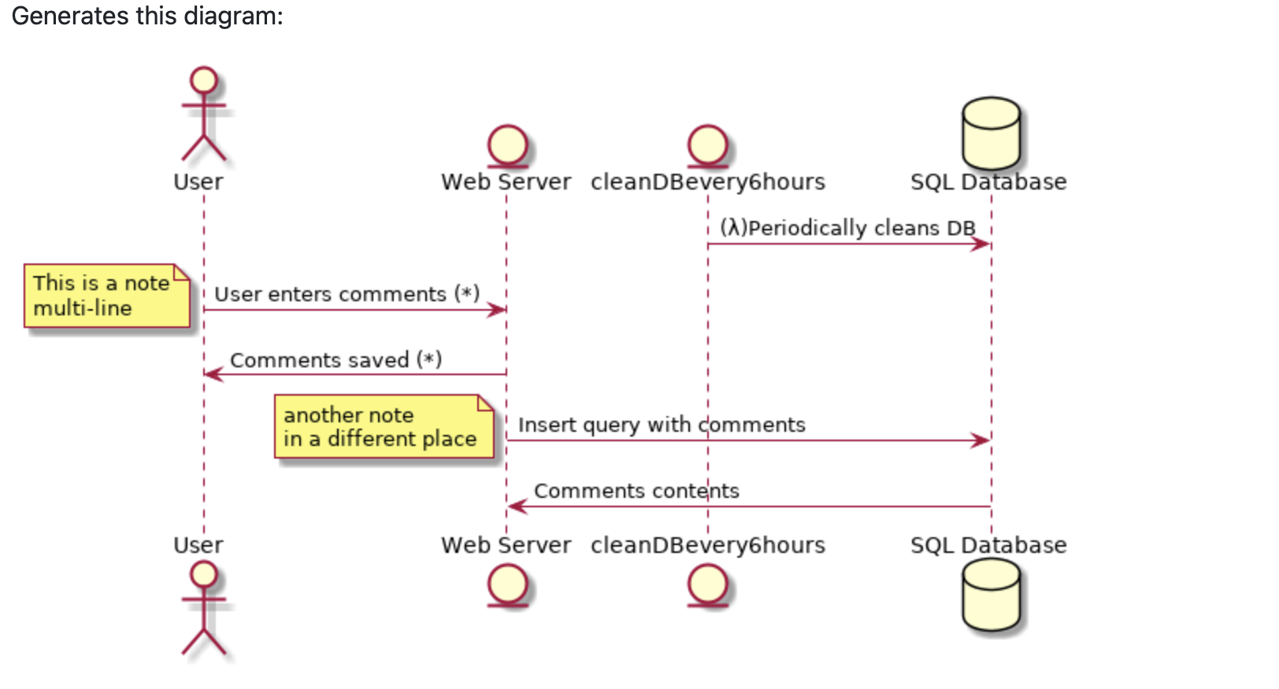
tm.py --seq | java -Djava.awt.headless=true -jar plantuml.jar -tpng -pipe > seq.png

Slide 23
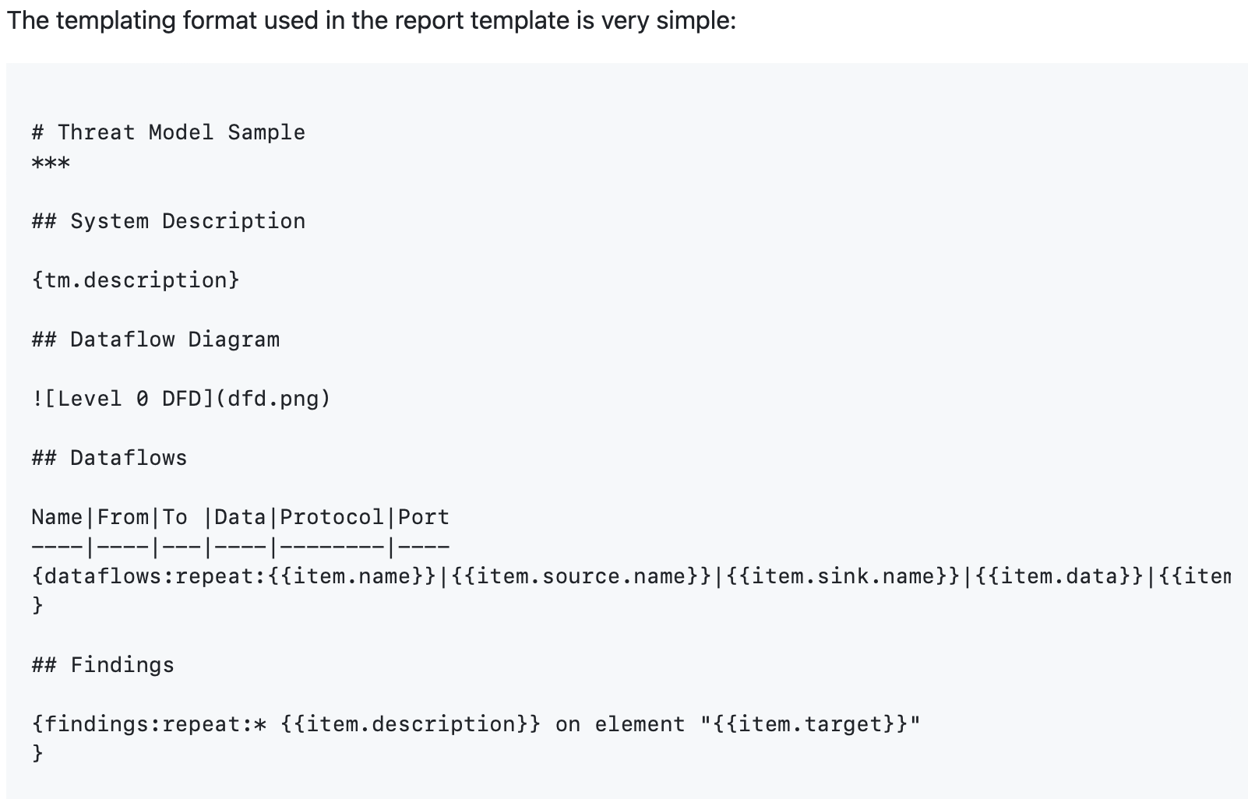
Creating a Report
The diagrams and findings can be included in the template to create a final report: tm.py --report docs/basic_template.md | pandoc -f markdown -t html > report.html

Slide 24
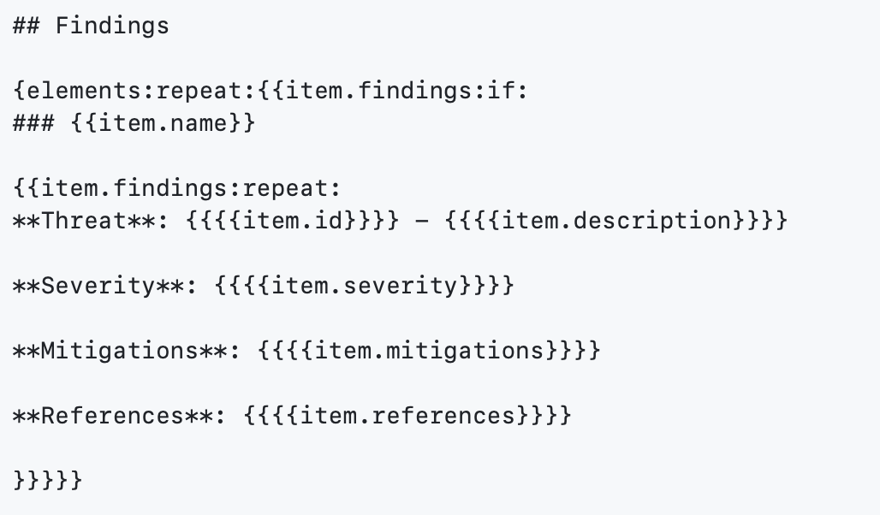
To group findings by elements, use a more advanced, nested loop:

Slide 25
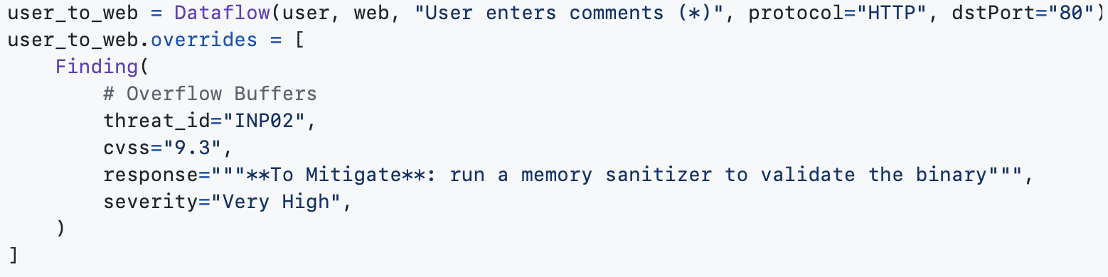
Overrides
You can override attributes of findings (threats matching the model assets and/or dataflows), for example to set a custom CVSS score and/or response text:

Slide 26
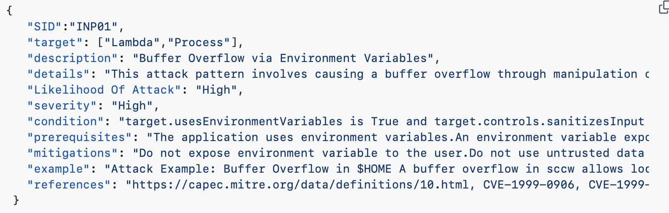
Threats database
For the security practitioner, you may supply your own threats file by setting TM.threatsFile. It should contain entries like:

